Slide 1
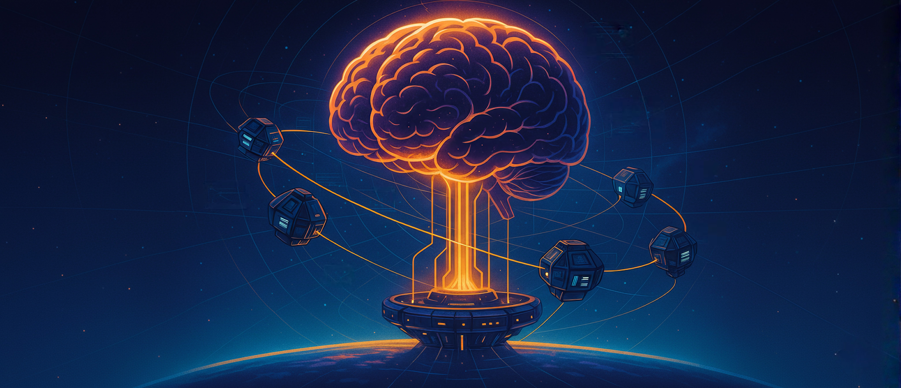
LLM Engineering
MASTER AI & LARGE LANGUAGE MODELS

Slide 2
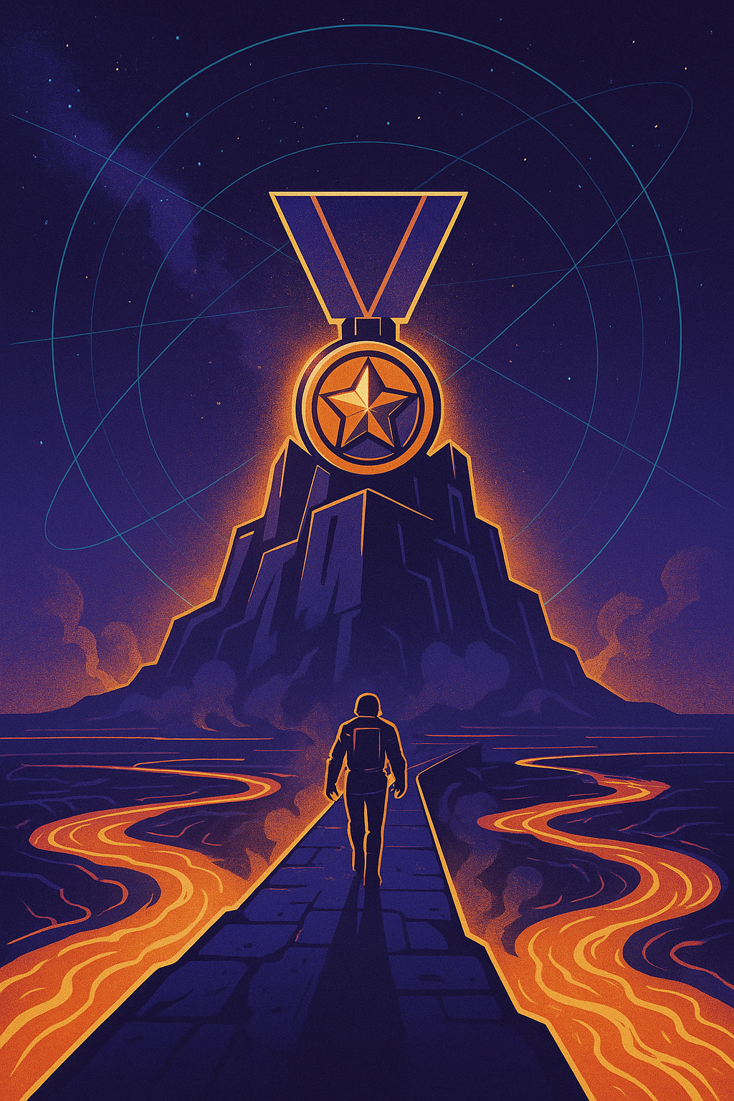
WEEK 8 DAY 3
Agentic AI
What you can now do
Generate text & code with Frontier Models and Open Source models using APIs and Hugging Face, with tools, Structured Outputs, assistants and RAG
Follow a 5 step strategy to solve problems, including dataset curation, making a baseline model, and fine-tuning a Frontier model
Confidently carry out the end-to-end process for selecting and training specialized open source models that can outperform the Frontier
Deploy multiple models to production including proprietary LLMs on Modal, a RAG workflow with Frontier models, and Neural Networks, with structured outputs
After today you will also be able to
Understand Agent Orchestration and use of Tools
Build a Planning Agent with an Agent Loop

Slide 3





The Hallmarks of an Agentic AI solution
Breaking a larger problem into smaller steps carried out by individual processes / models
Using Tools / Function Calling / Structured Outputs
An Agent Environment in which Agents can collaborate
A Planning Agent that coordinates activities
Autonomy & Memory - existing beyond a chat with a human

Slide 4











Agent Workflows
Scanner Agent
Frontier Agent
Identifies promising deals
RAG pricer
The UI
The Agent Framework
Planning Agent
In Gradio
Memory, logging
Coordinates activities
Ensemble Agent
Specialist Agent
Estimates prices
Estimates prices
Messaging Agent
Neural Network Agent
Sends push notifications
Estimates prices

Slide 5
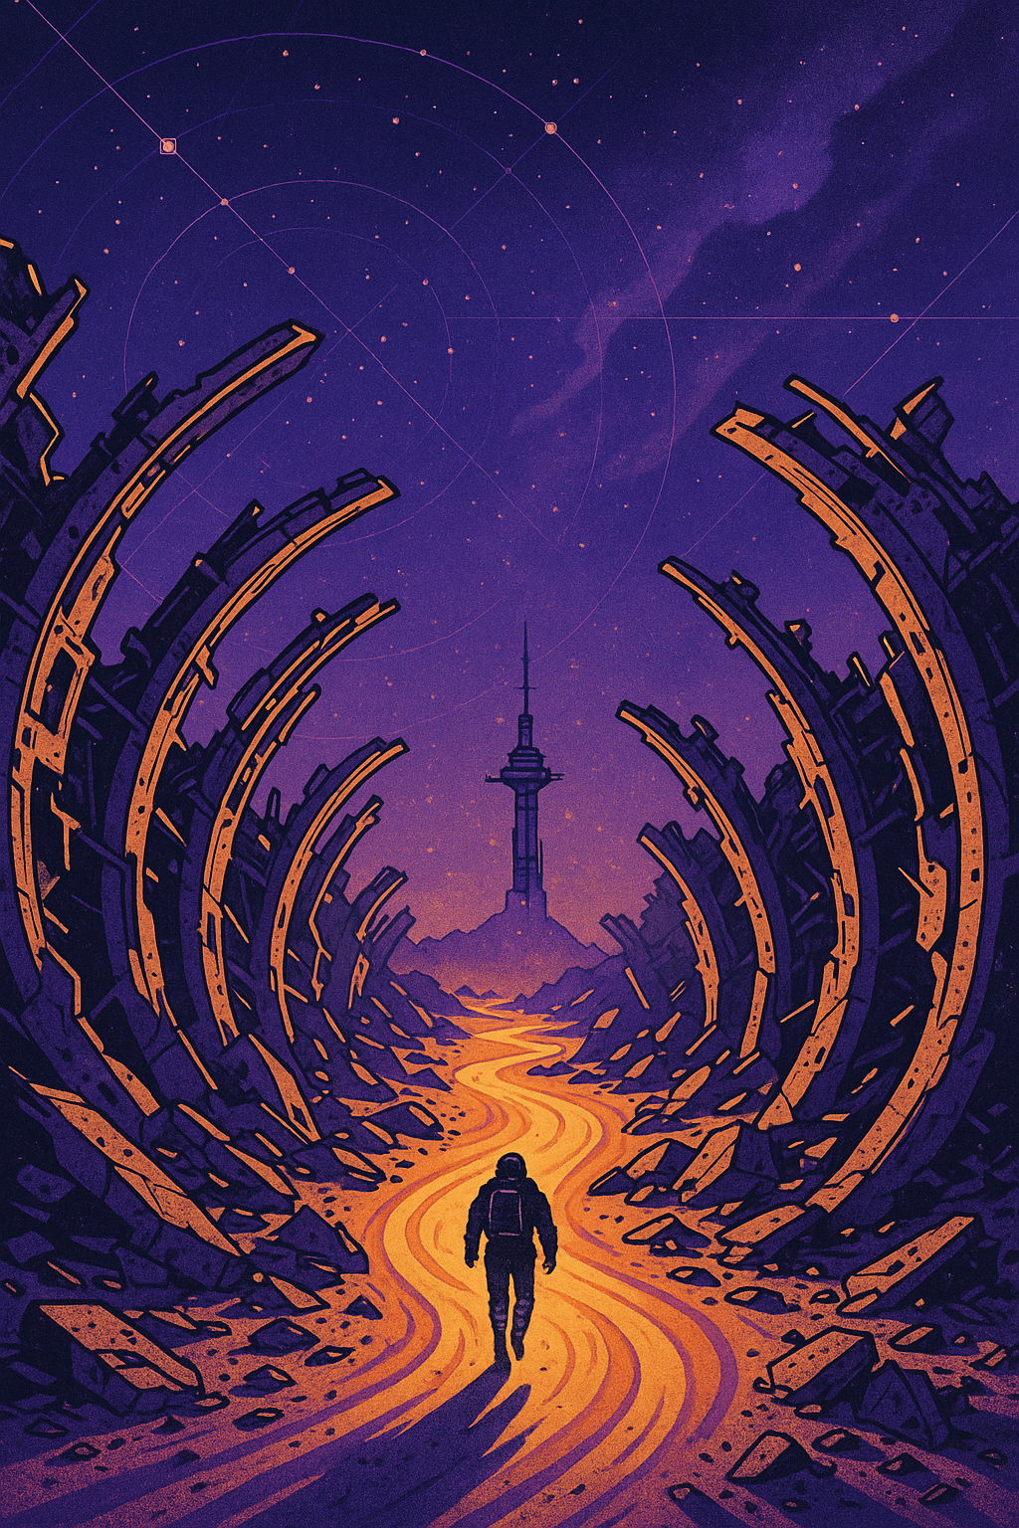
WEEK 8 DAY 4
One. Day. Left.
What you can now do
Generate text & code with Frontier Models and Open Source models using APIs and Hugging Face, with tools, Structured Outputs, assistants and RAG
Follow a 5 step strategy to solve problems, including dataset curation, making a baseline model, and fine-tuning a Frontier model
Confidently carry out the end-to-end process for selecting and training specialized open source models that can outperform the Frontier
Build a solution with multiple models including proprietary LLMs on Modal, a RAG workflow with Frontier models, and Neural Network, and use Structured Outputs
After tomorrow you will also be able to
Build Agentic Workflows with Planning, Memory, Database and multiple Agents collaborating to solve a complex task
Be an AI Engineer!

